Slide 1
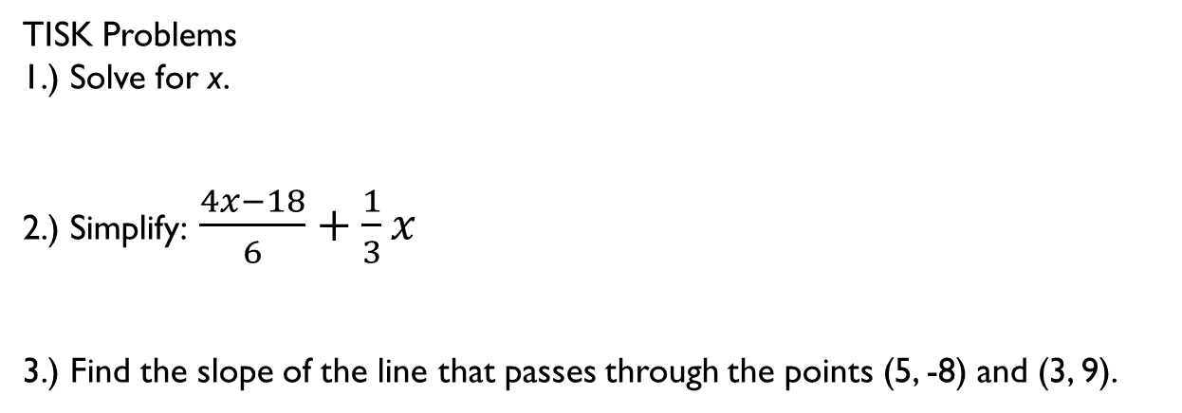




Thursday, November 29, 2012
Agenda:
TISK Problems & 2 MM
Lesson 6-4: Rhombi & Squares
Homework: Chapter 6 Packet 2 #1-10
$$92°$$
TISK Problems
1.) Solve for x.
2.) Simplify: $\frac{4x−18}{6}+\frac{1}{3}x$
3.) Find the slope of the line that passes through the points (5, -8) and (3, 9).
$$x+16°$$
$$x°$$
$$2x°$$
Notes:
Mental Math
1.) Start with the number of weeks in a year. Divide by 4. Square it. Add 27. Take the square root. Subtract 17. Write the absolute value of your answer. (3)
2.) Start with the number of nickels in a dollar. Square it. Subtract 144. Take the square root. Subtract 9. Write the absolute value of your answer. (7)

Slide 2
§6.4 Rhombi & Squares
Definitions
  Rhombus
    A parallelogram is a rhombus if and only if it has 4 congruent sides.
  Square
    A parallelogram is a square if and only if it has 4 congruent sides and 4 congruent (right) angles.

Slide 3
Example. Describing special parallelograms.
Complete the sentence with always, sometimes, or never.
  A square is _________ a rectangle.
  A rectangle is _________ a rhombus.
  A rhombus is _________ a square.
  A square is _________ a rhombus.
  A rectangle is _________ a square.
  A rhombus is _________ a rectangle.
always
sometimes
sometimes
always
sometimes
sometimes

Slide 4
Example. Using properties.
sides
Def. Rhombus.
congruent
If a quad. is a //ogram then opp. sides are congruent
congruent
If a quad. is a //ogram then opp. angles are congruent
bisect each other
If a quad. is a //ogram then diags. bisect each other.
supplementary
If a quad. is a //ogram then consec. angles are supplementary.

Slide 5
Corollary
Square Corollary
  A quadrilateral is a square if and only if it is both a rectangle and a rhombus.

Slide 7
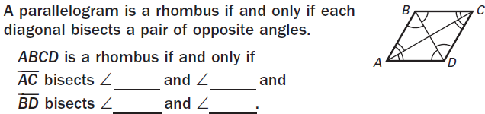
Theorems
perpendicular
BAD
BCD
ABC
ADC

Slide 8
Example. Checking a Square.
congruent
rhombus
congruent
rectangle
rectangle
square

